Slide 1
Metagenomic Profiling Using mOTUs
Local Installation & Analysis of Unmapped Reads
Andrew Reid and Asylzhan Almukhamet

Slide 2
Project Goal
Our project had three main goals:
Profile microbial composition using paired-end FASTQ files.
Use mOTUs v3 locally, since it can detect organisms other tools miss.
Generate and interpret species-level abundance tables from unmapped reads.

Slide 3
What is mOTUs
marker gene (MG)-based operational taxonomic units
mOTUs is marker-gene based tool for taxonomic profiling of metagenomes, uses single-copy universal marker genes instead of full reference genomes
mOTUs are built on the basis of MGs from both known and unknown species
Notes:
latter of which are extracted from existing metagenomes, enabling higher taxonomic resolution and more accurate quantification of species when profiling new microbial communities

Slide 4
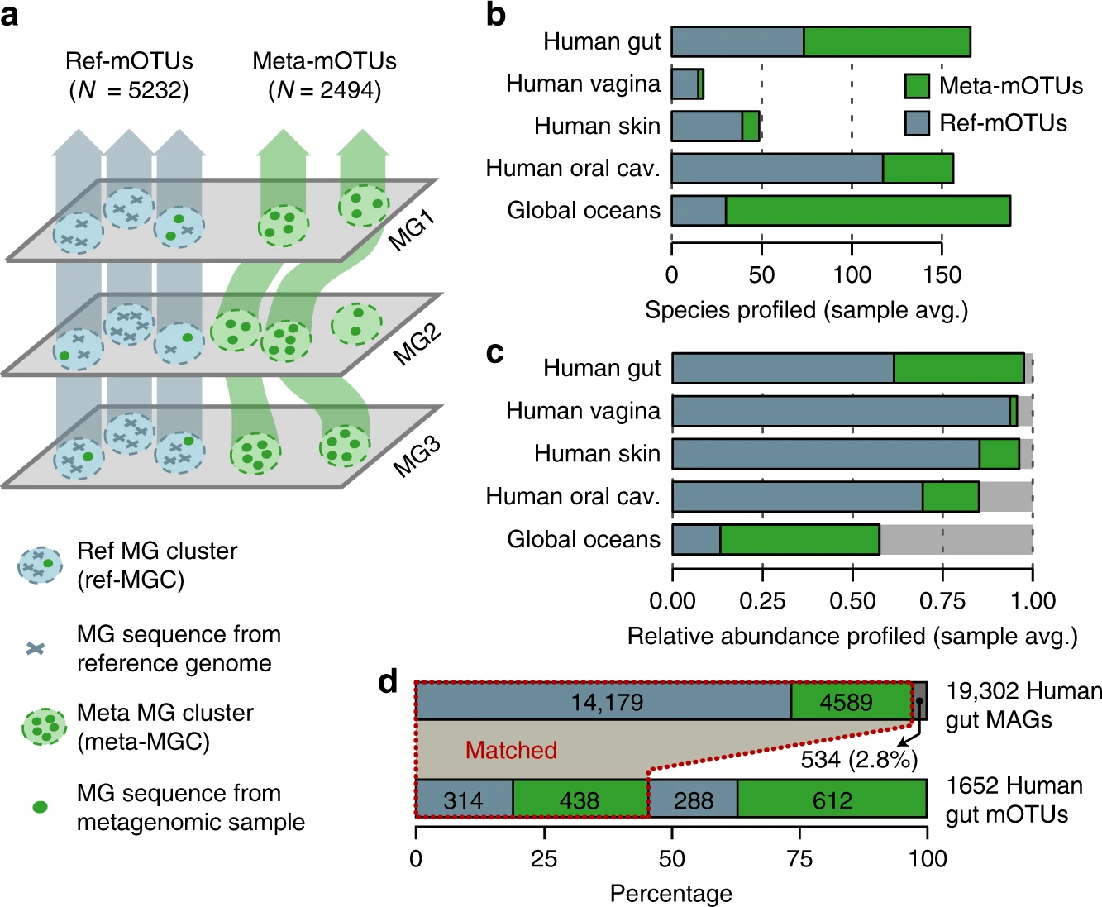
Construction of marker gene-based OTUs (mOTUs) for metagenomic profiling
Notes:
a) Schematic illustration of the mOTUs concept (Methods).
b) The observed richness of ref-mOTUs (containing exclusively MG sequences from reference genomes; blue) and meta-mOTUs (containing only MG sequences from metagenomes; green) per biome, and
c) mean cumulative relative abundance of species profiled across 2481 metagenomic samples.
d) Correspondence between mOTUs and 19,302 metagenome assembled genomes (MAGs) from the human gut. While less than 3% of MAGs are not represented (dark grey bar), mOTUs allow for profiling of 900 species not captured by MAGs.

Slide 5
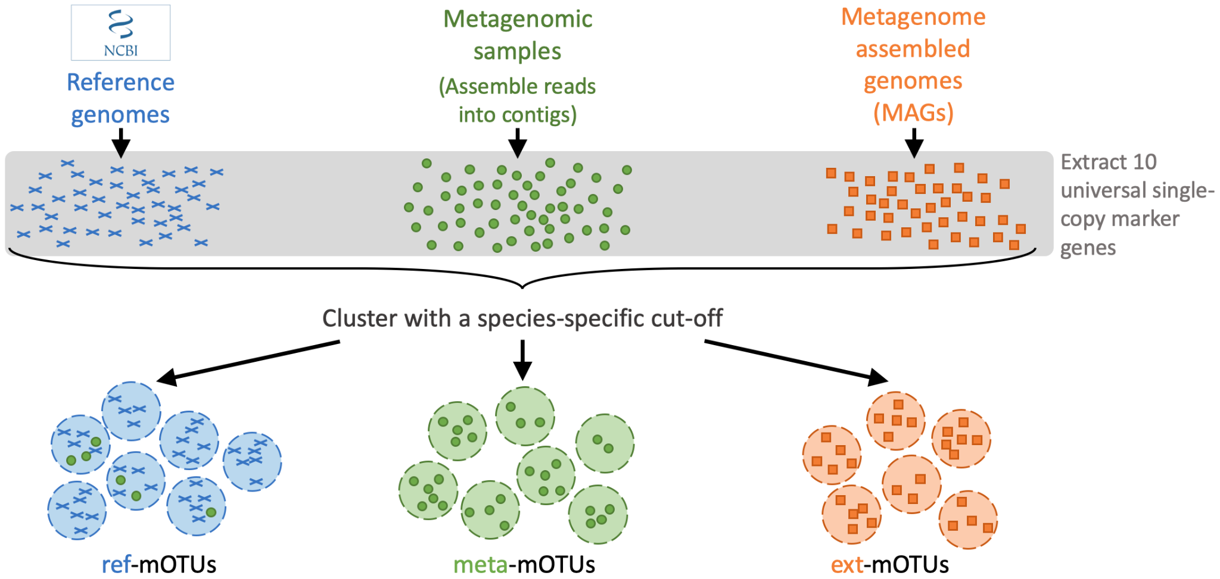
How mOTUs works?
Notes:
The mOTUs tool performs taxonomic profiling of metagenomics and metatrancriptomics samples, i.e. it identifies species and their relative abundance present in a sample. It is based on a set of mOTUs (~species) contained in the mOTUs database. The mOTUs database is created from reference genomes, metagenomic samples and metagenome assembled genomes (MAGs).
A mOTUs database is composed of three types of mOTUs:
ref-mOTUs, which represent known species,
meta-mOTUs, which represent unknown species obtained from metagenomic samples,
ext-mOTUs, which represent unknown species obtained from MAGs.
Note that meta- and ext-mOTUs will not have a species level annotation.

Slide 6
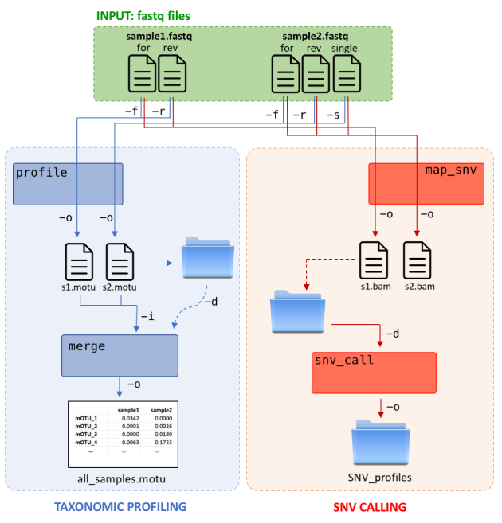
General Workflow
This is our complete workflow:
Start with paired-end FASTQ files
Detect marker genes
Quantify read counts
Normalize abundance
Produce a taxonomic profile
Notes:
1. Input Data
INPUT: fastq files (Green Box)
This is the raw data input.
sample1.fastq is shown as having both forward (for) and reverse (rev) reads, indicating it's paired-end sequencing data.
sample2.fastq is shown as having forward (for), reverse (rev), and single reads, suggesting a mix or separate handling of paired and orphaned reads.
2. Taxonomic Profiling (Blue Shaded Area)
This process aims to determine the microbial composition (the taxonomy) of the samples.
Profile Step (profile)
It takes the raw fastq files as input.
The connections show command-line arguments:
-f (forward reads) and -r (reverse reads) from sample1.fastq and sample2.fastq go into the profile step.
The output (-o) for each sample is a .motu file (e.g., s1.motu, s2.motu), which likely contains the relative abundance or counts of mOTUs (Metagenomic Operational Taxonomic Units) for that specific sample.
The blue folder with a dashed arrow and -d (directory) indicates that the raw output files might also be stored in an intermediate directory.
Merge Step (merge)
It takes the individual sample output files (s1.motu, s2.motu) as input, indicated by the -i (input) argument.
This step combines the individual profiles into a single, comprehensive table.
The final output (-o) is all_samples.motu, which is displayed as a table showing mOTU relative abundances across all samples (e.g., mOTU_1, mOTU_2, etc. with values for sample1 and sample2).
3. SNV Calling (Red Shaded Area)
This process aims to identify single nucleotide variants in the microbial community genomes.
SNV Mapping Step (map_snv)
It also takes the raw fastq files as input.
For sample2.fastq, it uses the forward (-f), reverse (-r), and single (-s) reads.
The process maps the reads to a reference genome/database (implied).
The output (-o) for each sample is a .bam file (e.g., s1.bam, s2.bam). A BAM file is the binary, compressed version of a SAM (Sequence Alignment/Map) file, which contains the aligned reads.
The red folder with dashed arrows and -d indicates intermediate storage of alignment files.
SNV Calling Step (SNV_call)
It takes the alignment files (s1.bam, s2.bam) as input.
It uses the alignment information to identify locations where the sequenced reads differ from the reference genome, thereby calling variants (SNVs).
The output (-o) is stored in a folder named SNV_profiles, which contains the results of the variant calling, likely including position, reference base, variant base, and frequency/depth information for each identified SNV.

Slide 7
Why mOTUs?
Good for detecting uncharacterized microorganisms
Handles unmapped reads extremely well
Lightweight enough to run on a personal laptop
Produces species-level abundance tables

Slide 8
Data used
Paired-end FASTQ files:
  evol1.sorted.unmapped.R1.fastq
  evol1.sorted.unmapped.R2.fastq
Unmapped reads from a larger shotgun metagenomics pipeline
These represent sequences not aligned to the host genome

Slide 9
Attempt on Picotte
We attempted:
Setting up Singularity / Apptainer
Pulling the mOTUs container
Binding class data directories
Running the profiling job
Issues:
Cache conflicts
NFS lock errors
No job execution
Container partially corrupted

Slide 10
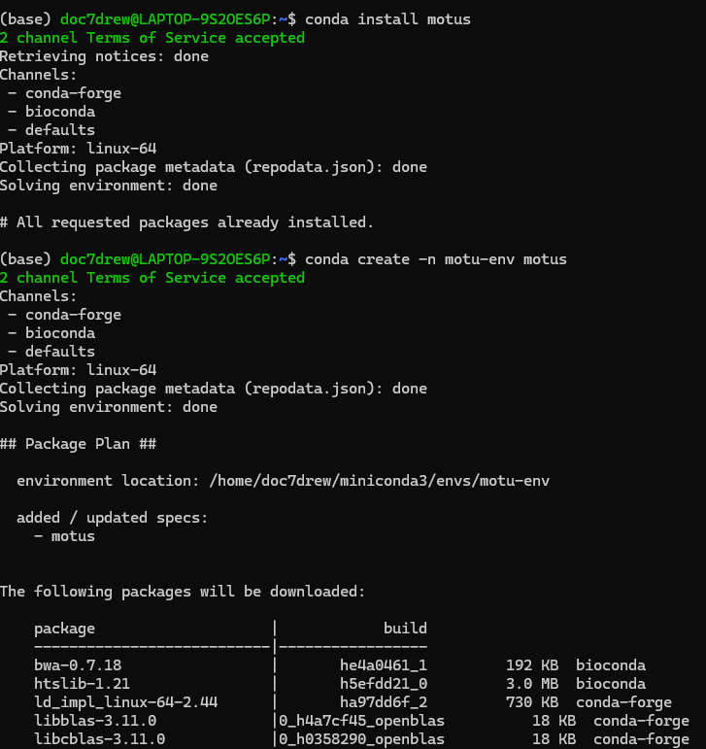
Local installation of mOTUs

Slide 11
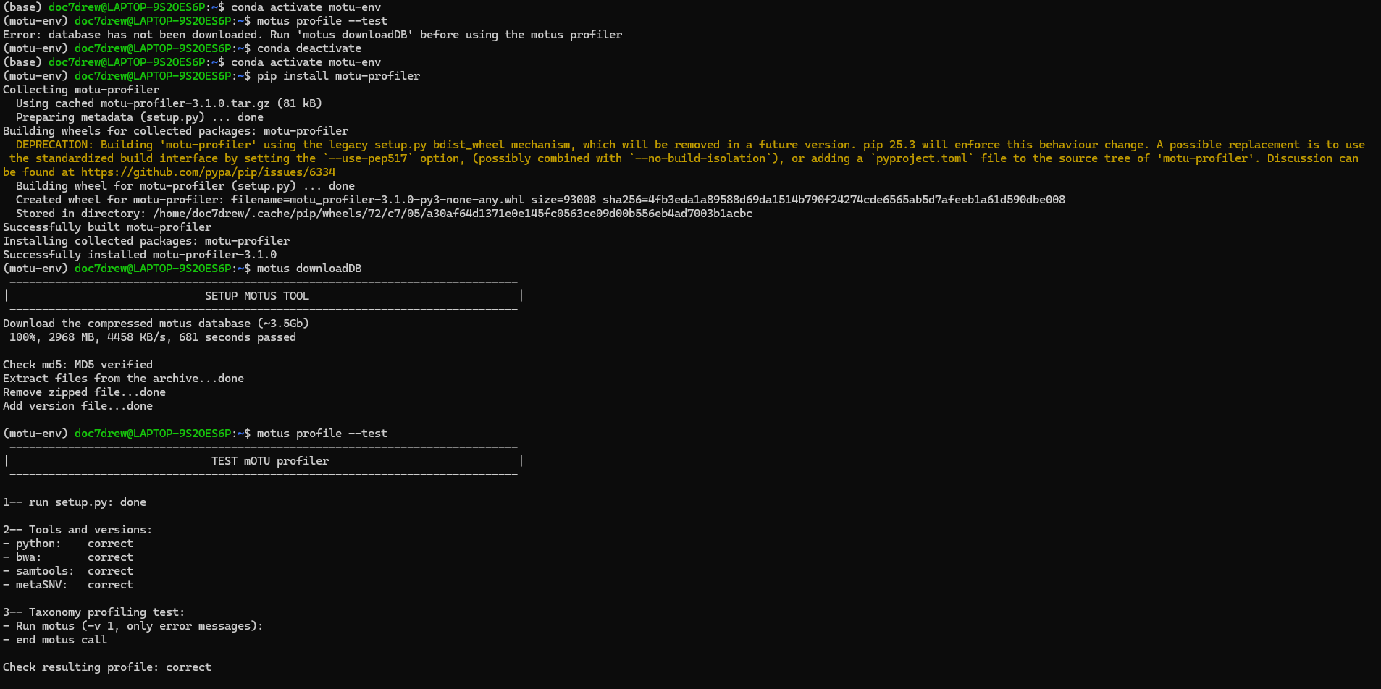
Local installation cont

Slide 12
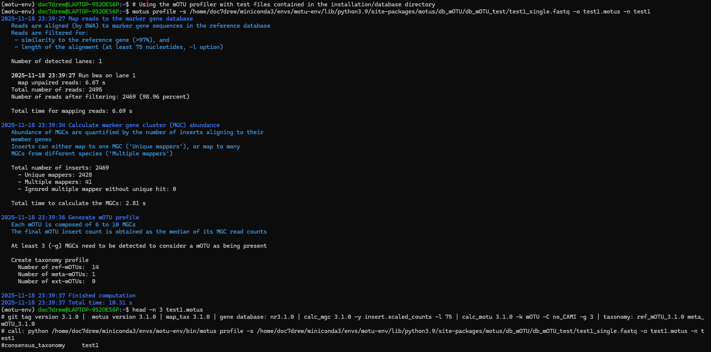
Notes:
resulting profile reports the relative abundance for each mOTU (ref + meta + ext)

Slide 13
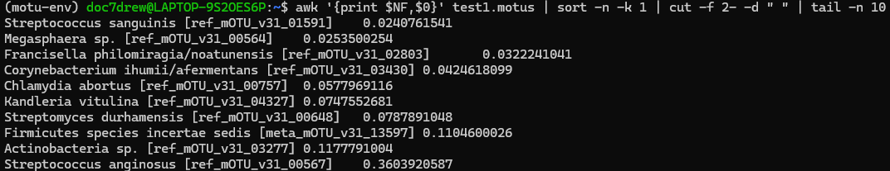
Notes:
Last 10
Adds up to around 0.78

Slide 14
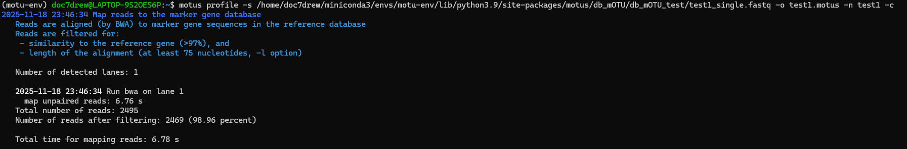
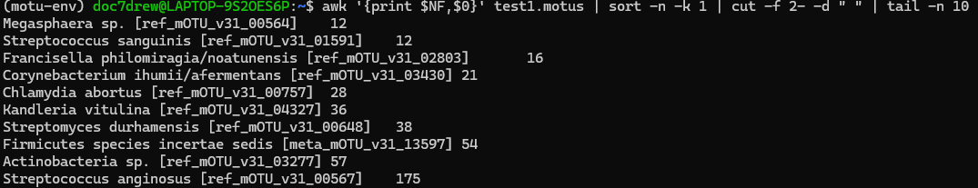
Notes:
The -c flag changes the output from relative abundance to number of assigned reads

Slide 15
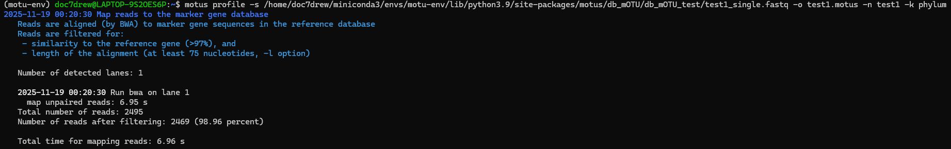
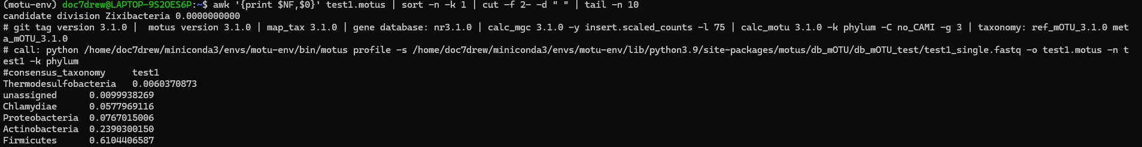
Notes:
The -k flag changes taxonomic level

Slide 16
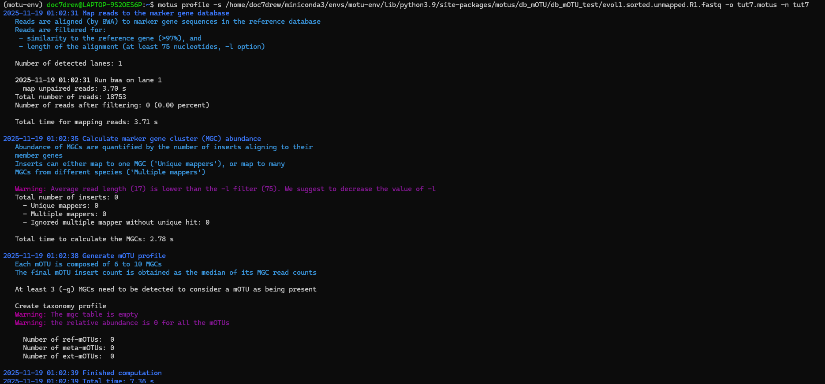
A Test File

Slide 17
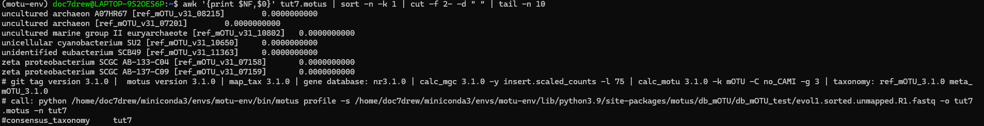
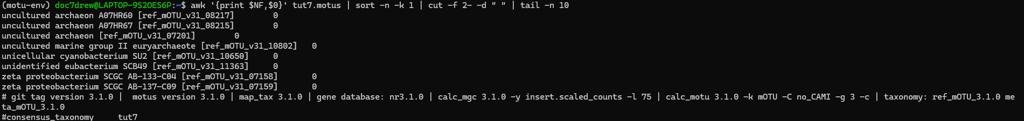
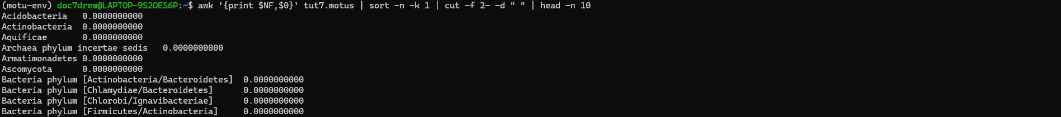
Notes:
Relative abundance, count, taxonomic level - phylum

Slide 18
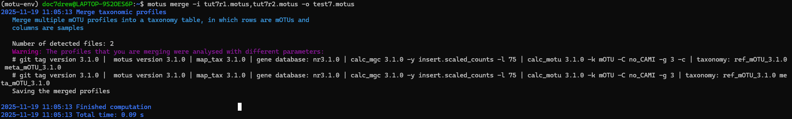
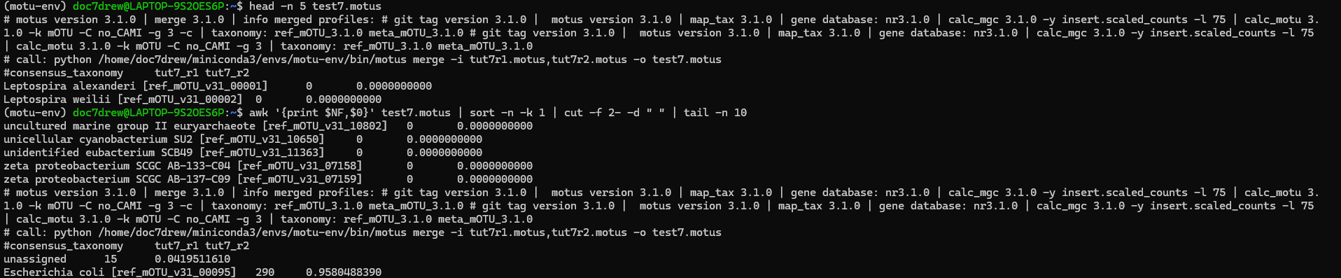
Merge

Slide 19
Results summary
We successfully ran mOTUs v3 on the paired FASTQ files.
The run processed 2609 reads, with 677 reads mapped to marker genes (26%).
A total of 14 mOTUs were detected (11 reference mOTUs, 3 meta-mOTUs, 0 extended mOTUs).
The top species by read count included Streptococcus anginosus, Actinobacteria sp., and Firmicutes incertae sedis.
Relative abundance values showed Streptococcus anginosus dominating (~36% of all assigned reads).

Slide 20
Biological interpretation
High-level microbial diversity
Presence of novel organisms
Possible biological relevance
Unmapped reads often reveal hidden species
mOTUs detects organisms missed by Kraken2, MetaPhlAn, etc.

Slide 21
What we learned
How to install and run mOTUs
How to work with FASTQ paired-end reads
Understanding output abundance tables
Importance of reproducible workflows
Troubleshooting computational pipelines

Slide 22
Reference
Milanese, Alessio, Daniel R. Mende, Lucas Paoli, Guillem Salazar, Hans-Joachim Ruscheweyh, Miguelangel Cuenca, Pascal Hingamp, Renato Alves, Paul I. Costea, Luis Pedro Coelho, Thomas S. B. Schmidt, Alexandre Almeida, Alex L. Mitchell, Robert D. Finn, Jaime Huerta-Cepas, Peer Bork, Georg Zeller, and Shinichi Sunagawa. 2019. "Microbial abundance, activity and population genomic profiling with mOTUs2." Nature Communications 10 (1): 1014. https://doi.org/10.1038/s41467-019-08844-4.
https://motu-tool.org/tutorial.html

